Slide 1
CS 208, Class – 9: Borg – Precursor to Kubernetes Large-scale cluster management at Google with Borg
By: Abhishek Verma, Luis Pedrosa, Madhukar Korupolu, David Oppenheimer, Eric Tune, John Wilkes
Slides based on Eurosys 2015 paper presentation
Adapted from a version initially by Xianghan Pei

Slide 2
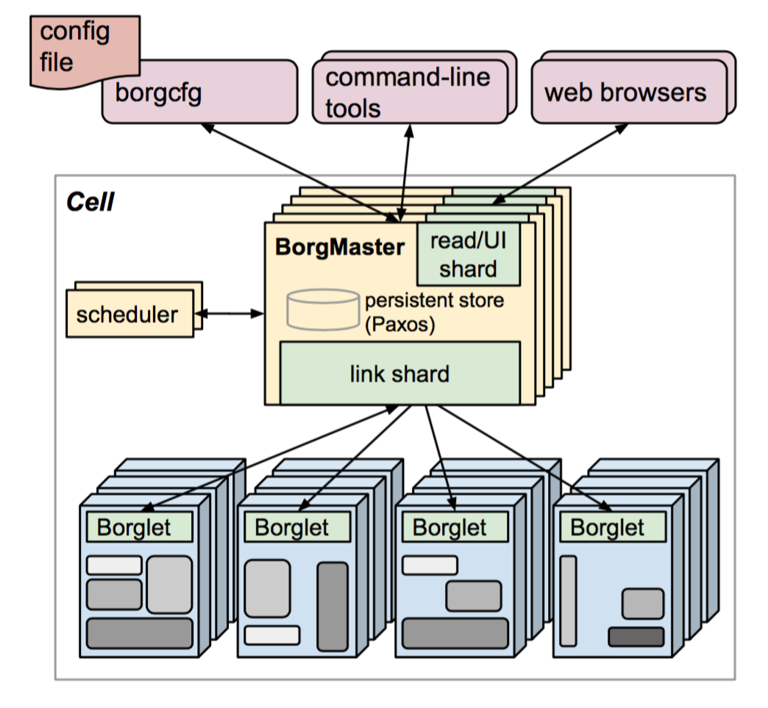
Introduction & Motivation
Introduction
Borg: An OS of Cluster(Datacenter)
Motivation
Hide the details(programmer focus on App)
Provide resource sharing
Provide high reliability and availability for Cluster
Borg isolates users from heterogeneity: determines where in a cell to run tasks; allocating their resources; installing programs and other dependencies; monitoring health; restarting them if they fail.
Machines in a cell belong to a single cluster
Median cell size is about 10 k machines
The high-level architecture of Borg
Notes:
Borg admits, schedules, starts, and monitors the full range of applications that Google runs. Just like the OS for single mechine.

Slide 3
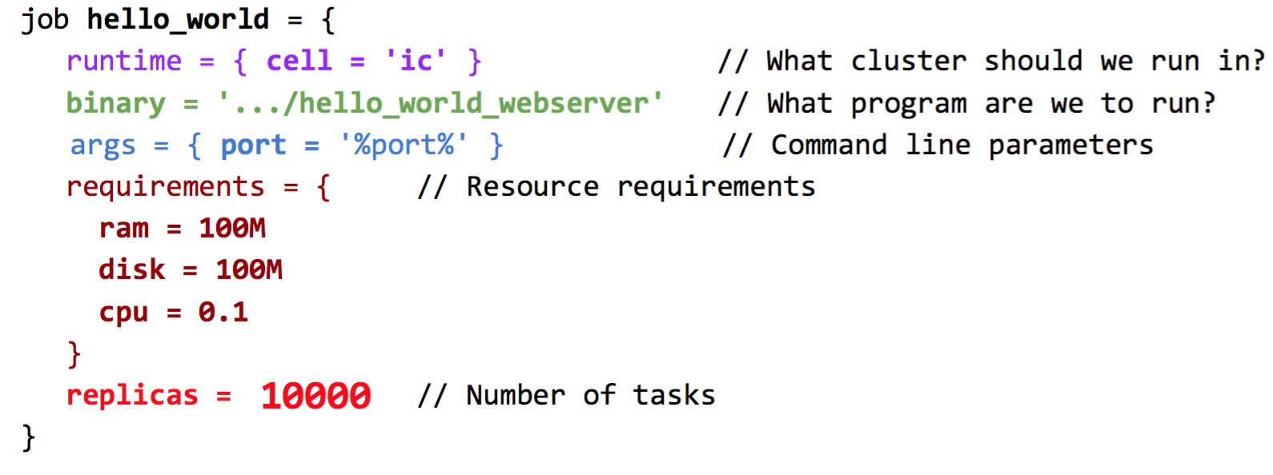
The User Perspective
Workload
production(prod) VS. non-production(non-prod)
Cells
Heterogeneous, around 10 k machines in median
Jobs and Tasks
Don’t need to know which data center
Maybe multiple of these apps run: system picks port
> borgcfg .../hello_world_webserver.borg up
Need 50 MB: lots of monitoring: each app is a Web
Server. Info on perf., stats, RPC calls made etc.
Can monitor how well it’s doing.
Notes:
Cells are connected by high-speed network fabric.
Use configuration language to write requirement for the job

Slide 4
The User Perspective
Allocs
Reserved set of resources
Priority, Quota, and Admission Control
Job has a priority (preempting)
Quota is used to decide which jobs to admit for scheduling
Naming and Monitoring
50.jfoo.ubar.cc.borg.google.com
Monitoring health of the task and thousands of performance metrics

Slide 5
Borg Architecture
Borgmaster: master for cell (subset of cluster)
May have more than 1 cell in a cluster
Borgcfg sends config file to Borgmaster: write to
persistent store
Main Borgmaster process & Scheduler
Scheduler aware of entire cell (in persistent data base)
Writes which nodes are selected to run job to
persistent store. Link shard executes the scheduler
decision
Master may have replicas (Five replicas)
Borglet – agent on each machine
Manage and monitor tasks and resource
Borgmaster polls Borglet every few seconds
Check with persistent store
The high-level architecture of Borg(A Cell)

Slide 6
Borg Architecture (contd.)
A Borg cell consists of a set of machines, a logically centralized controller called the Borgmaster, and an agent process called the Borglet that runs on each machine in a cell
Each cell’s Borgmaster (replicated 5 times) consists of two processes: the main Borgmaster process and a separate scheduler
A single elected master per cell serves both as the Paxos leader and the state mutator, handling all operations that change the cell’s state, such as submitting a job or terminating a task on a machine.
A master is elected (using Paxos)
The Borgmaster’s state at a point in time is called a checkpoint, and takes the form of a periodic snapshot plus a change log kept in the Paxos store.
For recovery: restore Borgmaster’s state to an arbitrary point in the past
Borg records all job submissions and task events & detailed per-task resource usage information – collected from Borglets
Data is used for usage-based charging, debugging job and system failures, and long-term capacity planning.

Slide 7
Scheduling a DataCenter
Companies like Google, run large datacenters
Construction, maintenance, etc. of datacenters has significant cost, and uses a significant amount of power
Managing such a data center efficiently is an important problem
Users submit jobs consisting of tasks (all tasks of a given job run the same program).
Jobs can have constraints to force its tasks to run on machines with particular attributes such as processor architecture, OS version, or an external IP address.

Slide 8
The computing environment – model for Google
long-running services - “never” go down, and handle short-lived latency-sensitive requests (a few μs to a few hundred ms). End-user-facing products such as Gmail, Google Docs, and web search (high priority)
batch jobs (a few seconds to a few days completion time); less sensitive to short-term performance fluctuations (low priority)
Tasks are the unit that is scheduled.
Each task maps to a set of Linux processes running in a container on a machine
So, they have:
Mix of long-running and short-running jobs.
Mix of user-facing and back-end jobs.
Mix of high and low priority jobs.
Consider a “datacenter” with thousands of machines, and a time period (“day”) long enough to have hundreds of thousands of tasks.

Slide 9
Borg Architecture
Scheduling
feasibility checking: find machines for a task
Scoring: pick one of the feasible machines.
Scoring: minimize number and priority of preempted tasks; pick machines that already have a copy of the task’s packages; spread tasks across power and failure domains; packing quality, including putting a mix of high and low priority tasks onto a single machine to allow the high-priority ones to expand in a load spike.
User preferences & built-in criteria
E-PVM vs. best-fit
Tradeoffs (see paper)
Decisions stored in persistent store
The high-level architecture of Borg(A Cell)
E-PVM places VMs on a server with the lowest utilization to leave a large headroom
for load spikes w/goal of good task completion time.
Notes:
feasibility checking, to find machines on which the task could run
scoring, which picks one of the feasible machines.
The scoring system is a combine of user-specified preferences & build-in criteria: picking machines that already have a copy of the task’s packages.

Slide 10
Scalability
Separate scheduler
Separate threads to poll the Borglets
Partition functions across the five replicas
Score caching: Cache score, ignore small changes
Equivalence classes: scoring one task per equivalence class
Relaxed randomization: don’t score all machines, choose random number of machines
The high-level architecture of Borg(A Cell)
Notes:
Score caching: Cache score, ignore small changes
Equivalence classes: scoring for one task per equivalence class
Relaxed randomization: don’t scores all machines, choose random number of machines.

Slide 11
Some ways to measure scheduling quality
Throughput - number of processed tasks
Total flow time – total time tasks spend in system
Total useful work – total time tasks spend processing work that will not be thrown away
Number of preemptions – times tasks were interrupted.
Pending queue size – number of tasks in system but not being scheduled
Machine fragmentation – roughly the number of unused machines

Slide 12
How to model machines and jobs
Machines:
Disk
Memory
CPU
Jobs
Consist of set of tasks, which have
Requirements: Cpu, disk, memory, precedence, priority, etc.
Expected: Processing times
Long list of other possible constraints

Slide 13
Primary Goals
Increase throughput.
Reduce machine fragmentation (increase job packing ability).
Increase the number of unused machines (potential for power savings).
Example for Google Production jobs:
Important to understand allocation vs. usage
E.g., CPU allocation: 70% of the total CPU resources; CPU usage: 60% of the total;
Memory allocation: about 55% of the total memory; usage: about 85% of the total memory allocated.

Slide 14
Allocations
Borg alloc: reserved set of resources on a machine in which one or more tasks can be run;
resources remain assigned whether or not used.
Allocs can be used to set aside resources for future task executions, to retain resources between stopping a task and starting it again;
An alloc set is like a job: it is a group of allocs that reserve resources on multiple machines.
Once an alloc set has been created, one or more jobs can be submitted to run in it.
Consolidate tasks from different jobs onto the same machine

Slide 15
Naming and Monitoring
A service’s clients and other systems need to be able to find tasks, even after they are relocated to a new machine.
Task Name: Borg creates a stable “Borg name service” (BNS) name for each task that includes the cell name, job name, and task number.
Borg writes the task’s hostname and port into a consistent, highly-available file
Used by RPC system to find the task endpoint
E.g., 50th task in job jfoo owned by user ubar in cell cc would be reachable via 50.jfoo.ubar.cc.borg.google.com.
Every task run under Borg contains a built-in HTTP server that publishes information about the health of the task and (1000s) of performance metrics

Slide 16
The Algorithmic Guts of Scheduling
Given a task, we need to choose a machine:
Filter out the set of machines it can run on
Compute score(i,j) on each remaining machine i (in that filtered set), for task j.
Assign task to lowest scoring machine.
The multidimensional nature of fitting a job on a machine makes the scoring problem challenging.

Slide 17
Algorithms
If we place task j on machine i , then
free_ram_pct(i) =
free ram on i (after scheduling j) / total ram on i
free_cpu_pct(i) =
free cpu on i (after scheduling j) / total cpu on i
free_disk_pct(i) =
free disk on i (after scheduling j) / total disk on i

Slide 18
Algorithms
Bestfit: Place job on machine with “smallest available hole”
V1: score(i,j) = free_ram_pct(i) + free_cpu_pct(i)
V2: score(i,j) = free_ram_pct(i)² + free_cpu_pct(i)²
V3: score(i,j) = 10 ^{free_ram_pct(i)} + 10 ^{free_cpu_pct(i)}
V4: score(i,j) = 10 ^{free_ram_pct(i)} + 10 ^{free_cpu_pct(i)} + 10 ^{free_disk_pct(i)}
V5: score(i,j) = max(free_ram_pct(i), free_cpu_pct(i))
Firstfit: Place job on first machine with a large enough hole
V1: score(i,j) = machine_uid
V2: score(i,j) = random(i) (chosen once, independent of j)
Sum-Of-Squares: tries to create a diverse set of free machines
Worst Fit (EPVM): score(i,j) =
- (10 ^{free_ram_pct(i)} + 10 ^{free_cpu_pct(i)} + 10 ^{free_disk_pct(i)} )
Random: Random placement

Slide 19
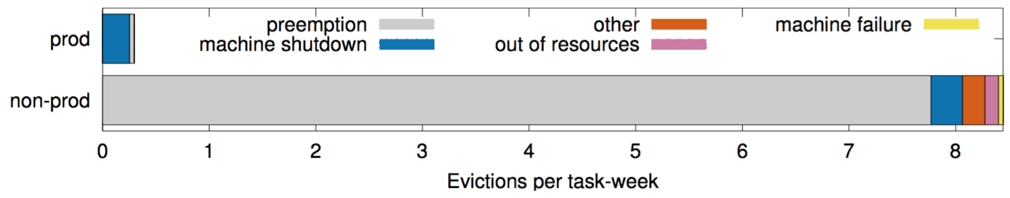
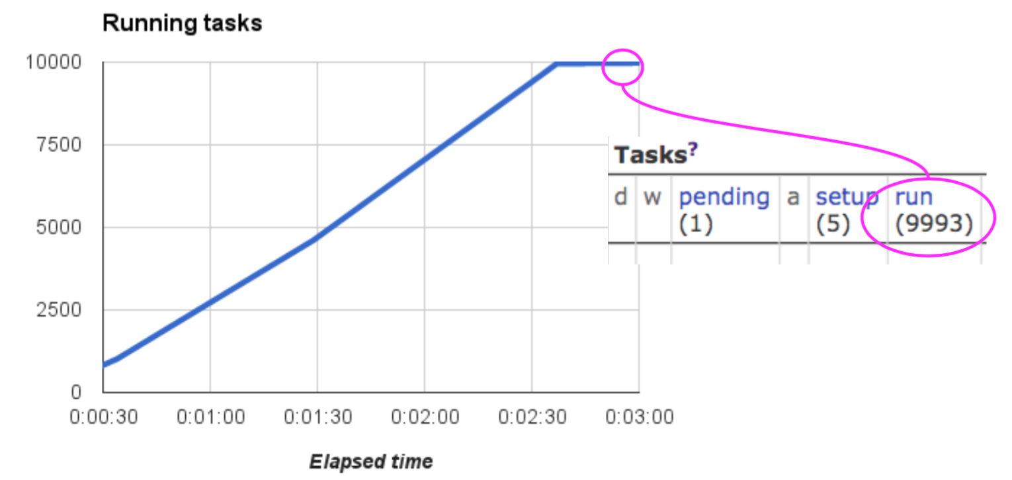
Availability
Production jobs: gmail
Non-prod: Map-Reduce – can
be pre-empted
System: resilience
Borgmaster: Five replicas
Borglet: Borgmaster keep-alive
Take checkpoint
Job
Reschedules evicted tasks (Linux process group)
Spreading tasks across failure domain
Doesn‘t quite get to 10K jobs…
Design focus in large systems: around failures; upgrades
2.5 mins to start
10K – bottlenecked
at the storage server
20 GB/s

Slide 20
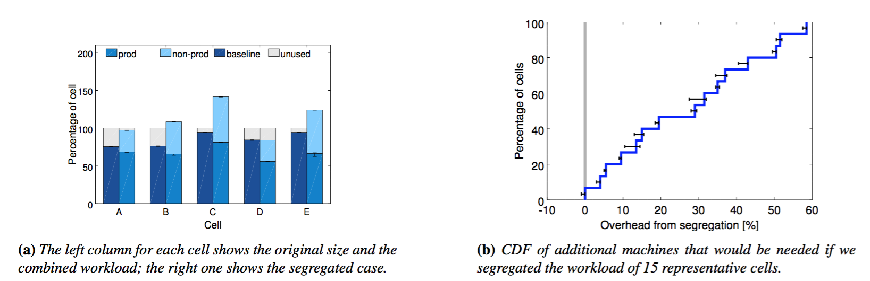
Utilization
Cell Sharing
Segregating prod and non-prod work into different cells would need more machines
50% of the cells see less than 30% additional overhead.

Slide 21
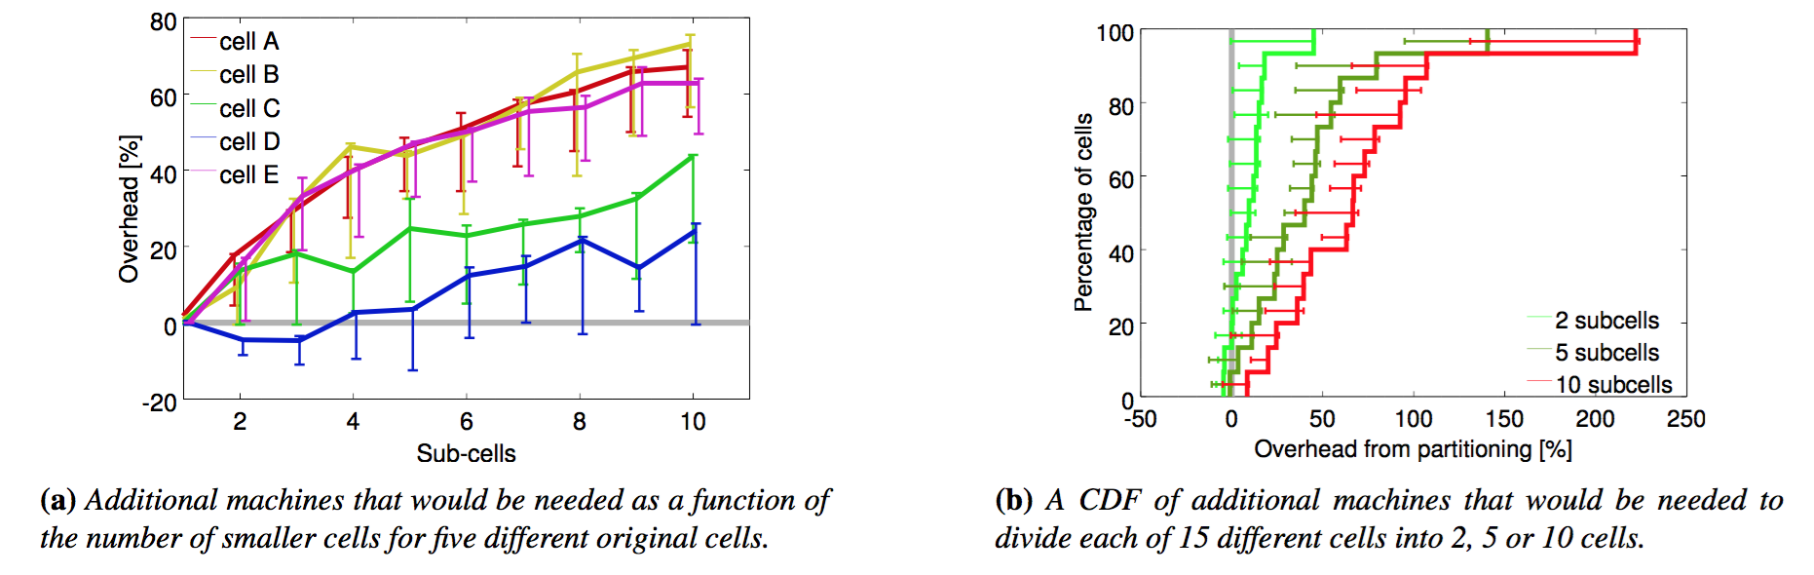
Utilization
Cell Size
Subdividing cells into smaller ones would require more machines

Slide 22
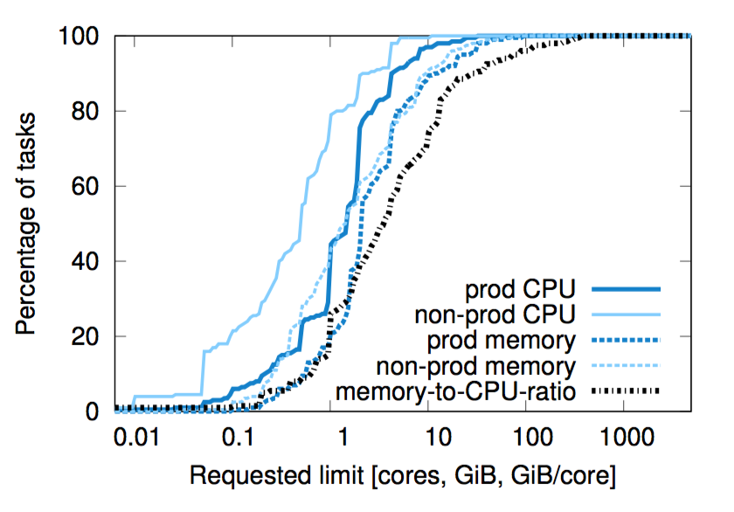
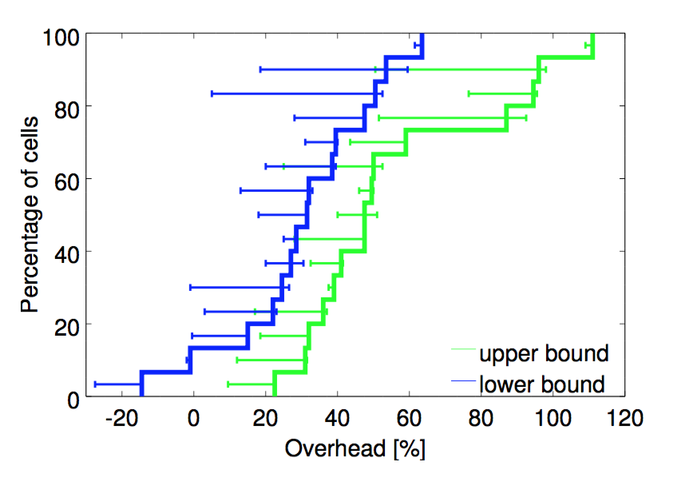
Utilization
Fine-grained resource requests
No bucket sizes fit most of the tasks well
Bucketing resource would need more machines
No bucket sizes fit most of the tasks well.
CDF of requested CPU and memory requests across our sample cells.
No one value stands out, although a few integer CPU core
sizes are somewhat more popular.

Slide 23
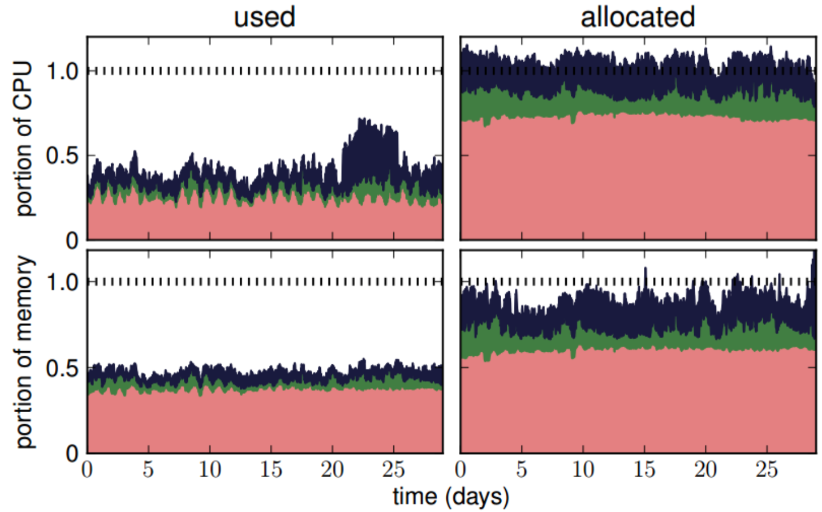
Utilization – Efficient use of resources in Data Center
Resource reclamation
estimate how many resources a task will use and reclaim the rest for allocation to new tasks
Kill non-prod jobs if no resources are available (pre-emption)
Need to be concerned about one resource (CPU) being available, but not another (memory): stranded resources.
5 different dimensions to worry about (I/O, network etc.)

Slide 24
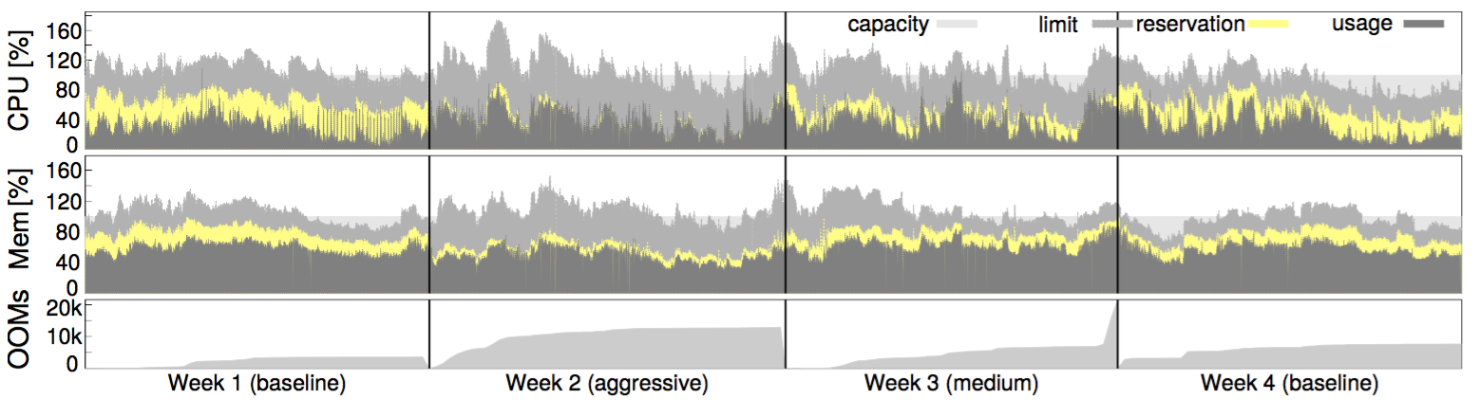
Utilization
Resource reclamation
More aggressive resource estimation can reclaim more resources, with little effect on out-of-memory events (OOMs).
A timeline (starting on 2013-11-11) for one production cell of usage, reservation and limit averaged over 5-minute windows
and cumulative out-of- memory events; the slope of the latter is the aggregate rate of OOMs.
Vertical bars separate weeks with different resource estimation settings.
Choose medium

Slide 25
Isolation
Security isolation
chroot jail as the primary security isolation mechanism
Performance isolation
High-priority LV task(prod) get best treatment
compressible resources: reclaimed
non-compressible resources: kill or remove task

Slide 26
Lessons
Bad
Jobs are restrictive as the only grouping mechanism for tasks
One IP address per machine complicates things
Optimizing for power users at the expense of casual ones
Good
Allocs are useful
Cluster management is more than task management
Introspection is vital
The master is the kernel of a distributed system

Slide 27
Future Work (now present)
Kubernetes
Evolved from Borg
An open-source system for automating deployment, operations, and scaling of containerized applications
Pods: groups of containers
Labels
Replica controller
Services

Slide 28
References
Borg Paper: Eurosys 2015
Borg Slides at InfoQ

